Slide 1
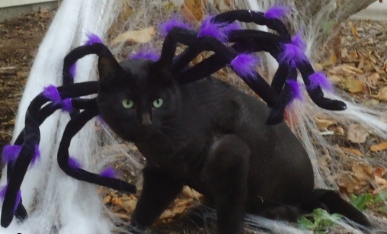
Overview of the Web

Slide 2


Slides adapted from …
Computer Networking: A Top Down Approach 6th edition Jim Kurose, Keith Ross Addison-Wesley March 2012
A note on the use of these ppt slides:
We’re making these slides freely available to all (faculty, students, readers). They’re in PowerPoint form so you see the animations; and can add, modify, and delete slides (including this one) and slide content to suit your needs. They obviously represent a lot of work on our part. In return for use, we only ask the following:
If you use these slides (e.g., in a class) that you mention their source (after all, we’d like people to use our book!)
If you post any slides on a www site, that you note that they are adapted from (or perhaps identical to) our slides, and note our copyright of this material.
Thanks and enjoy! JFK/KWR
All material copyright 1996-2012
J.F Kurose and K.W. Ross, All Rights Reserved
Notes:
What is the Internet?

Slide 3















What is the Internet: a service view
Mobile Network
Infrastructure that provides services to applications:
Web, VoIP, email, games, e-commerce, social nets, …
It provides programming interface to apps
hooks that allow sending and receiving app programs to “connect” to Internet
provides service options, analogous to postal service
Global ISP
Home
Network
Regional ISP
Institutional Network
Notes:
Network of networks
Remember the protocols?
TCP/UDP
IP/DNS
ISP internet?

Slide 4
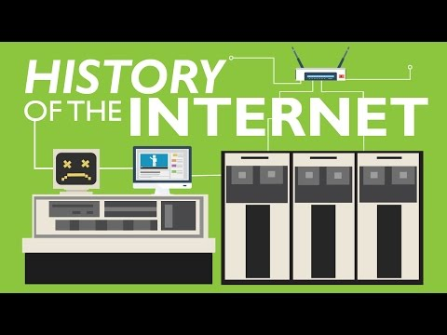
History of The Internet!

Slide 5
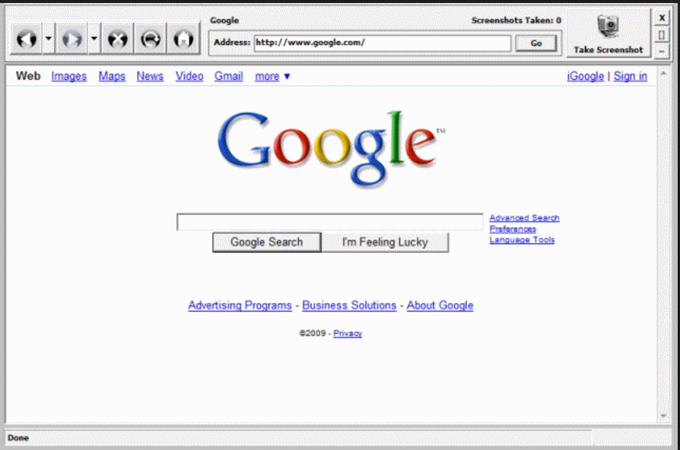
WEB PAGES
Static Web page
Dynamic Web Page
In simplest terms, static Web pages are those with content that cannot change without a developer editing its source code, while dynamic Web pages can display different content from the same source code.
What is important is the purpose each page serves for your website.

Slide 6
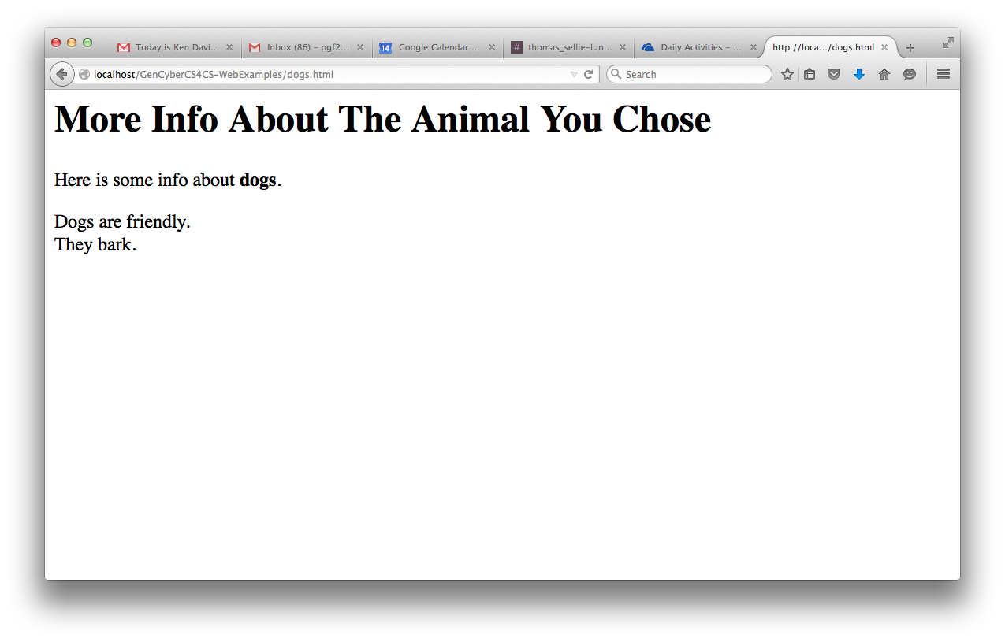
Static Web Page Request
The browser translates code to something pretty and readable for you.
The primary purpose of a web browser is to bring information resources to the user ("retrieval" or "fetching"), allowing them to view the information ("display", "rendering"), and then access other information ("navigation", "following links").
Web Server
File
system
<html>
<body>
<h1>More Info About The Animal You Chose</h1>
Here is some info about <b>dogs</b>.<br>
<p>Dogs are friendly.<br> They bark.</p>
</body>
</html>
Notes:
‹#›
Inspect Element.
The browser translates code to something pretty and readable for you.
The primary purpose of a web browser is to bring information resources to the user ("retrieval" or "fetching"), allowing them to view the information ("display", "rendering"), and then access other information ("navigation", "following links").
Hypertext Transfer Protocol (HTTP).
Uniform Resource Locator (URL),

Slide 7
Dynamic Web Page Request
http://45.55.88.146/animal.php?animal=dog
Web Server/
Application
Server
File
system
program
<html>
<body>
<h1>More Info About The Animal You Chose</h1>
Here is some info about <b>dogs</b>.<br>
<p>Dogs are friendly.<br> They bark.</p>
</body>
</html>
Notes:
‹#›
The website can display different content based on what operating system or browser the visitor is using, whether she is using a PC or a mobile device, or even the source that referred the visitor. A dynamic Web page is not necessarily better than a static Web page.

Slide 8
Where’d the domain name come from?
Where can I learn about dogs?
Search Engine
www.google.com?q=dogs
Check out www.ispeakdog.org
Notes:
‹#›

Slide 9
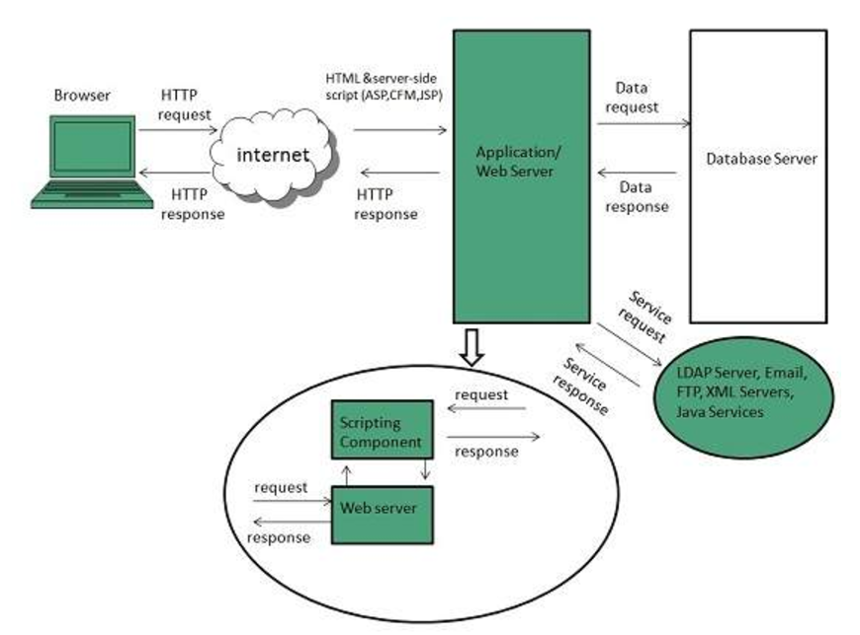
DYNAMIC WEBPAGE:

Slide 10
NETWORK LAYERING
A network application consists of pairs of processes that send messages to each other over a network.
For each pair of communicating processes, we typically label one of the two processes as the client and the other process as the server.
With the Web, a browser is a client process and a Web server is a server process.

Slide 11
Why layering?
dealing with complex systems:
explicit structure allows identification, relationship of complex system’s pieces
layered reference model for discussion
modularization (separation) eases maintenance, updating of system
change of implementation of layer’s service transparent to rest of system

Slide 12
Internet protocol stack
application: Provide applications services to users and programs
FTP, SMTP, HTTP
transport: process-process data
transfer
TCP, UDP
network: routing of datagrams
from source to destination
IP, routing protocols
link: data transfer between neighboring network elements
Ethernet, 802.111 (WiFi), PPP
physical: bits “on the wire” (or in the air)
application
transport
network
link
physical

Slide 13
Some network apps
e-mail
web
text messaging
remote login
P2P file sharing
multi-user network games
streaming stored video (YouTube, Hulu, Netflix)
voice over IP (e.g., Skype)
real-time video conferencing
social networking
search
…
…

Slide 14


Client-server architecture
server:
always-on host
permanent IP address
data centers for scaling
clients:
communicate with server
may be intermittently connected
may have dynamic IP addresses
do not communicate directly with each other
client/server

Slide 15
App-layer protocol defines
types of messages exchanged,
e.g., request, response
message syntax:
what fields in messages & how fields are delineated
message semantics
meaning of information in fields
rules for when and how processes send & respond to messages
open protocols:
defined in RFCs
allows for interoperability
e.g., HTTP, SMTP
proprietary protocols:
e.g., Skype

Slide 16
What transport service does an app need?
data integrity
some apps (e.g., file transfer, web transactions) require 100% reliable data transfer
other apps (e.g., audio) can tolerate some loss
throughput
some apps (e.g., multimedia) require minimum amount of throughput to be “effective”
other apps (“elastic apps”) make use of whatever throughput they get
timing
some apps (e.g., Internet telephony, interactive games) require low delay to be “effective”
security
encryption, data integrity, …

Slide 17
DOMAIN NAME SERVICE
Domain Name Servers (DNS) are the Internet's equivalent of a phone book.
They maintain a directory of domain names and translate them to Internet Protocol (IP) addresses.

Slide 18
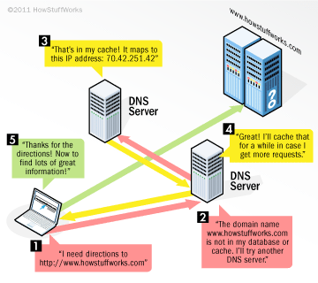
Domain Name Service (DNS)

Slide 19
Back to Application Layer: A closer look at Web and HTTP
web page consists of objects
object can be HTML file, JPEG image, Java applet, audio file,…
web page consists of base HTML-file which includes several referenced objects
each object is addressable by a URL, e.g.,
host name
path name
www.someschool.edu/someDept/pic.gif

Slide 20


HTTP overview
HTTP: hypertext transfer protocol
Web’s application layer protocol
client/server model
client: browser that requests, receives, (using HTTP protocol) and “displays” Web objects
server: Web server sends (using HTTP protocol) objects in response to requests
HTTP request
PC running
Firefox browser
HTTP response
HTTP request
server
running
Apache Web
server
HTTP response
iphone running
Safari browser

Slide 21
HTTP requests
Request … from …
Html
Jpg
program
program with parameters
What are some every day examples of these that you use?

Slide 22
Intro to HTML: Exercise
Review HTML summary
Write simple static web pages, upload them to the server, and browse each other’s pages
Advanced Challenge:
Write program to read in an html file, find font color tags, modify them, and output similar html page with different color scheme.

Slide 23

Writing an HTML Page
<title>
</title>

Slide 24
Set Up
Create a folder called mySite
Open through Activities Sublime Text
Create index.html
Create style.css
Create interactive.js

Slide 25
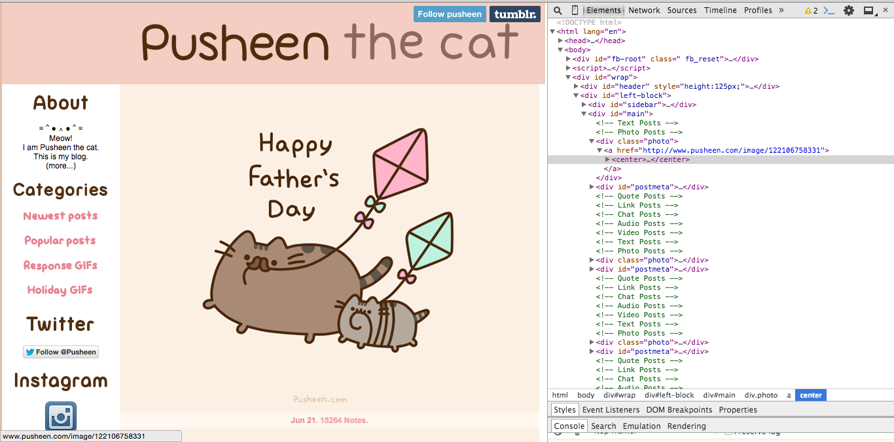
Follow Along

Slide 26
HTTP overview (continued)
uses TCP:
client initiates TCP connection (creates socket) to server, port 80
server accepts TCP connection from client
HTTP messages (application-layer protocol messages) exchanged between browser (HTTP client) and Web server (HTTP server)
TCP connection closed
HTTP is “stateless”
server maintains no information about past client requests
aside
protocols that maintain “state” are complex!
past history (state) must be maintained
if server/client crashes, their views of “state” may be inconsistent, must be reconciled

Slide 27
HTTP connections
non-persistent HTTP
at most one object sent over TCP connection
connection then closed
downloading multiple objects required multiple connections
persistent HTTP
multiple objects can be sent over single TCP connection between client, server

Slide 28
Non-persistent HTTP
suppose user enters URL:
(contains text,
references to 10
jpeg images)
www.someSchool.edu/someDepartment/home.index
1a. HTTP client initiates TCP connection to HTTP server (process) at www.someSchool.edu on port 80
1b. HTTP server at host www.someSchool.edu waiting for TCP connection at port 80. “accepts” connection, notifying client
2. HTTP client sends HTTP request message (containing URL) into TCP connection socket. Message indicates that client wants object someDepartment/home.index
3. HTTP server receives request message, forms response message containing requested object, and sends message into its socket
time
Notes:
All modern web browsers use persistent connections, including Google Chrome, Firefox, Internet Explorer (since 4.01), Opera (since 4.0)[8] and Safari.
Lower CPU and memory usage (because fewer connections are open simultaneously). Enables HTTP pipelining of requests and responses. Reduced network congestion (fewer TCP connections). Reduced latency in subsequent requests (no handshaking). Errors can be reported without the penalty of closing the TCP connection.
If the client does not close the connection when all of the data it needs has been received, the resources needed to keep the connection open on the server will be unavailable for other clients. How much this affects the server's availability and how long the resources are unavailable depend on the server's architecture and configuration.

Slide 29
Non-persistent HTTP (cont.)
4. HTTP server closes TCP connection.
5. HTTP client receives response message containing html file, displays html. Parsing html file, finds 10 referenced jpeg objects
time
6. Steps 1-5 repeated for each of 10 jpeg objects

Slide 30
HTTP request message
two types of HTTP messages: request, response
HTTP request message:
ASCII (human-readable format)
carriage return character
request line
(GET, POST,
HEAD commands)
line-feed character
GET /index.html HTTP/1.1\r\n
Host: www-net.cs.umass.edu\r\n
User-Agent: Firefox/3.6.10\r\n
Accept: text/html,application/xhtml+xml\r\n
Accept-Language: en-us,en;q=0.5\r\n
Accept-Encoding: gzip,deflate\r\n
Accept-Charset: ISO-8859-1,utf-8;q=0.7\r\n
Keep-Alive: 115\r\n
Connection: keep-alive\r\n
\r\n
header
lines
carriage return,
line feed at start
of line indicates
end of header lines

Slide 31
Uploading form input
POST method:
web page often includes form input
input is uploaded to server in entity body
URL method:
uses GET method
input is uploaded in URL field of request line:
www.somesite.com/animalsearch?monkeys&banana

Slide 32
Method types
HTTP/1.0:
GET
POST
HEAD
asks server to leave requested object out of response
HTTP/1.1:
GET, POST, HEAD
PUT
uploads file in entity body to path specified in URL field
DELETE
deletes file specified in the URL field

Slide 33
HTTP response message
status line
(protocol
status code
status phrase)
HTTP/1.1 200 OK\r\n
Date: Sun, 26 Sep 2010 20:09:20 GMT\r\n
Server: Apache/2.0.52 (CentOS)\r\n
Last-Modified: Tue, 30 Oct 2007 17:00:02 GMT\r\n
ETag: "17dc6-a5c-bf716880"\r\n
Accept-Ranges: bytes\r\n
Content-Length: 2652\r\n
Keep-Alive: timeout=10, max=100\r\n
Connection: Keep-Alive\r\n
Content-Type: text/html; charset=ISO-8859-1\r\n
\r\n
data data data data data ...
header
lines
data, e.g.,
requested
HTML file

Slide 34
HTTP response status codes
status code appears in 1st line in server-to-client response message.
some sample codes:
200 OK
request succeeded, requested object later in this msg
301 Moved Permanently
requested object moved, new location specified later in this msg (Location:)
400 Bad Request
request msg not understood by server
404 Not Found
requested document not found on this server
505 HTTP Version Not Supported

Slide 35
Trying out HTTP (client side) for yourself
1. Telnet to your favorite Web server:
telnet cis.poly.edu 80
opens TCP connection to port 80
(default HTTP server port) at cis.poly.edu.
anything typed in sent
to port 80 at cis.poly.edu
2. type in a GET HTTP request:
GET /~ross/ HTTP/1.1
Host: cis.poly.edu
by typing this in (hit carriage
return twice), you send
this minimal (but complete)
GET request to HTTP server
3. look at response message sent by HTTP server!
(or use Wireshark to look at captured HTTP request/response)

Slide 36
Fancier Web Pages: Exercise
CSS
Javascript

Slide 37


Slide 38
User-server state: cookies
example:
Susan always access Internet from PC
visits specific e-commerce site for first time
when initial HTTP requests arrives at site, site creates:
unique ID
entry in backend database for ID
many Web sites use cookies
four components:
1) cookie header line of HTTP response message
2) cookie header line in next HTTP request message
3) cookie file kept on user’s host, managed by user’s browser
4) back-end database at Web site

Slide 39
Cookies: keeping “state” (cont.)
client
server
ebay 8734
usual http request msg
Amazon server
creates ID
1678 for user
cookie file
usual http response
set-cookie: 1678
backend
database
create
entry
ebay 8734
amazon 1678
usual http request msg
cookie: 1678
cookie-
specific
action
access
usual http response msg
one week later:
access
ebay 8734
amazon 1678
usual http request msg
cookie: 1678
cookie-
specific
action
usual http response msg

Slide 40
Cookies (continued): Exercise
aside
what cookies can be used for:
authorization
shopping carts
recommendations
user session state (Web e-mail)
cookies and privacy:
cookies permit sites to learn a lot about you
you may supply name and e-mail to sites
how to keep “state”:
protocol endpoints: maintain state at sender/receiver over multiple transactions
cookies: http messages carry state

Slide 41

XSS & Cookies

Slide 42
Network security
field of network security:
how bad guys can attack computer networks
how we can defend networks against attacks
how to design architectures that are immune to attacks
Internet not originally designed with (much) security in mind
original vision: “a group of mutually trusting users attached to a transparent network” ☺
Internet protocol designers playing “catch-up”
security considerations in all layers!

Slide 43
Bad guys: put malware into hosts via Internet
malware can get in host from:
virus: self-replicating infection by receiving/executing object (e.g., e-mail attachment)
worm: self-replicating infection by passively receiving object that gets itself executed
spyware malware can record keystrokes, web sites visited, upload info to collection site
infected host can be enrolled in botnet, used for spam. DDoS attacks

Slide 44
Securing TCP
TCP & UDP
no encryption
cleartext passwds sent into socket traverse Internet in cleartext
SSL
provides encrypted TCP connection
data integrity
end-point authentication
SSL is at app layer
Apps use SSL libraries, which “talk” to TCP
SSL socket API
cleartext passwds sent into socket traverse Internet encrypted

Slide 45
Authentication
How do you know who you’re talking to?
Certificate Authorities
Digital signatures
Using RSA for digital signature
Exercise if time permits
Key exchange
In practice
Look for the lock
What’s encrypted and what isn’t

Slide 46
Digital Certificates
Digital certificates are used to verify authenticity of public keys.
Problem: when you communicate with a web site, how do you know if you are talking with the genuine web site or an imposter?
Solution: use the public key of the web site
Problem: how to verify if the public key itself is genuine?
Solution:
Every client (e.g., browser) has public keys of a few root-level certification authorities
A site can get its name/URL and public key signed by a certification authority: signed document is called a certificate
Client can use public key of certification authority to verify certificate
Multiple levels of certification authorities can exist. Each certification authority
presents its own public-key certificate signed by a higher level authority, and
uses its private key to sign the certificate of other web sites/authorities

Slide 47

Bad guys: attack server, network infrastructure
Denial of Service (DoS): attackers make resources (server, bandwidth) unavailable to legitimate traffic by overwhelming resource with bogus traffic
1. select target
2. break into hosts around the network (see botnet)
3. send packets to target from compromised hosts
target

Slide 48
Bad guys can sniff packets
packet “sniffing”:
broadcast media (shared ethernet, wireless)
promiscuous network interface reads/records all packets (e.g., including passwords!) passing by
A
C
src:B dest:A payload
B
wireshark software used for end-of-chapter labs is a (free) packet-sniffer

Slide 49
Bad guys can use fake addresses
IP spoofing: send packet with false source address
A
C
src:B dest:A payload
B
… lots more on security (throughout, Chapter 8)

Slide 50
Sources
Title cat: http://www.costume-works.com/spider_cat-2.html
Turtle: https://en.wikipedia.org/wiki/Turtles_all_the_way_down

